Slide 1
Continuous
Integration
Sundar Rajan Renganathan

Slide 2
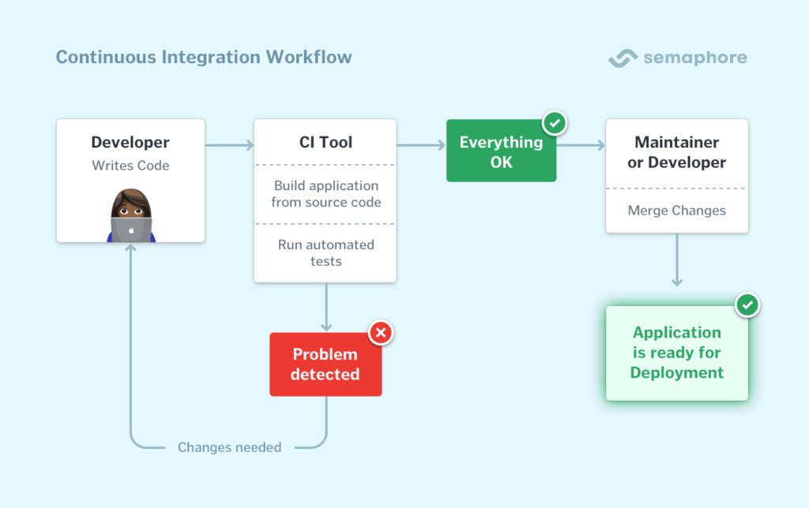
What is Continuous Integration?
Continuous integration is a DevOps software development practice where developers regularly merge their code changes into a central repository, after which automated builds and tests are run.
Continuous integration (CI) is the practice of automating the integration of code changes from multiple contributors into a single software project. It’s a primary DevOps best practice, allowing developers to frequently merge code changes into a central repository where builds and tests then run. Automated tools are used to assert the new code’s correctness before integration.

Slide 3
Basics
Tool | Example | Purpose / Usage | Output
SCM | GIT | To store the code & take care of version control | Source code
Build Script | Ant, Maven, Gradle | To build the code and produce the built artifacts | Artifacts – Jar, war, ear, dll, exe, tar, zip etc…
Artifact repository | Artifactory, Nexus | To store the artifacts (build output) | Artifacts – Jar, war, ear, dll, exe, tar, zip etc…
Static Code analysis | Sonarqube | To scan the code for coding standards, code coverage | Scan report and the quality gate result
Security scan | Veracode, checkmarx | To scan the code for security vulnerabilities | Scan report and the gate result
Unit testing | Junit | Unit test cases for testing the application code | Test report with overall result
Functional testing | Selenium, Jasmine, Karma etc.. | Functional test cases for testing the application | Test report with overall result
Containerization | Docker | To make it as a container which can be shipped across the environment | Container image
Image Registry | Dockerhub, ECR, Artifactory etc.. | To store the container images | Container images
Image scan | Black duck, artifactory | To scan the container images for vulnerabilities | Scan report with overall results

Slide 4
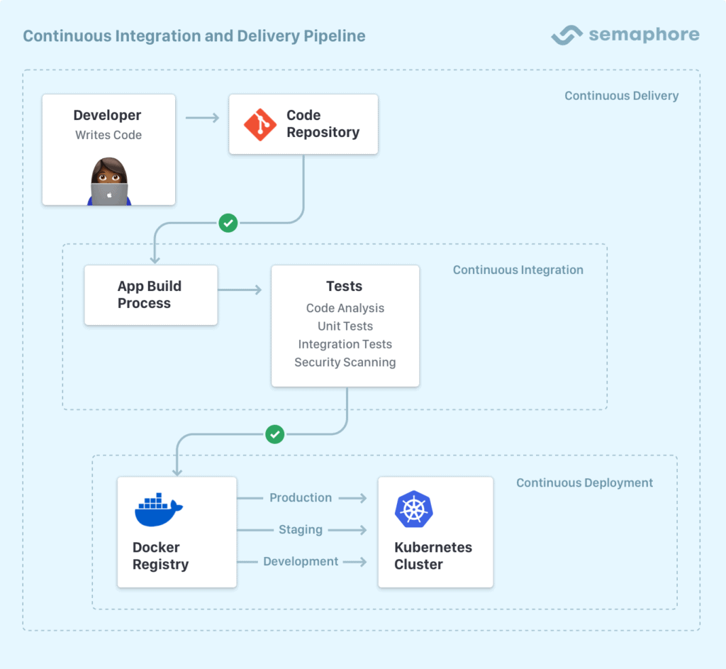
CI vs. CD vs. Continuous Delivery

Slide 5
CI Principles
Martin Fowler’s original principles of Continuous Integration
Maintain a code repository
Automate your build
Make your build self-testing
Daily commits to the baseline by everyone on the team
Every commit (to the baseline) should be built
Keep your builds fast
Clone the production environment and test there
Make it easy to get the latest deliverables
Everyone on the team can see the results of your latest build
Automate build deployment

Slide 6
Benefits of CI
Reduces Risk
Better Communication
Faster iterations
Faster feedback on business decisions
Reduces overhead across the development and deployment process
Reduces the time and effort for integrations of different code changes
Enables a quick feedback mechanism on every change
Allows earlier detection and prevention of defects
Helps collaboration between team members so recent code is always shared
Reduces manual testing effort
Building features more incrementally saves time on the debugging side so you can focus on adding features
First step into fully automating the whole release process
Prevents divergence in different branches as they are integrated regularly
If you have a long running feature you're working on, you can continuously integrate but hold back the release with feature flags.

Slide 7
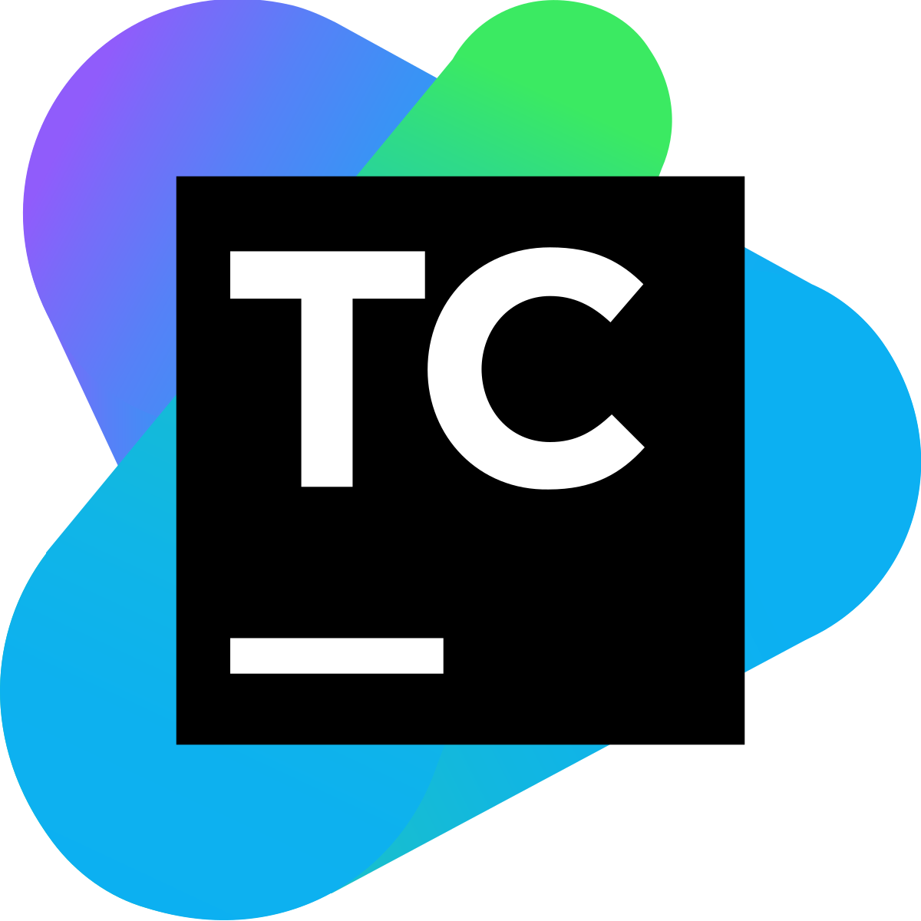





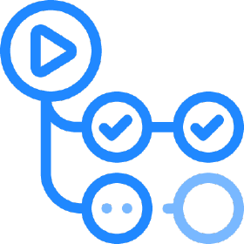



CI Tools

Slide 8
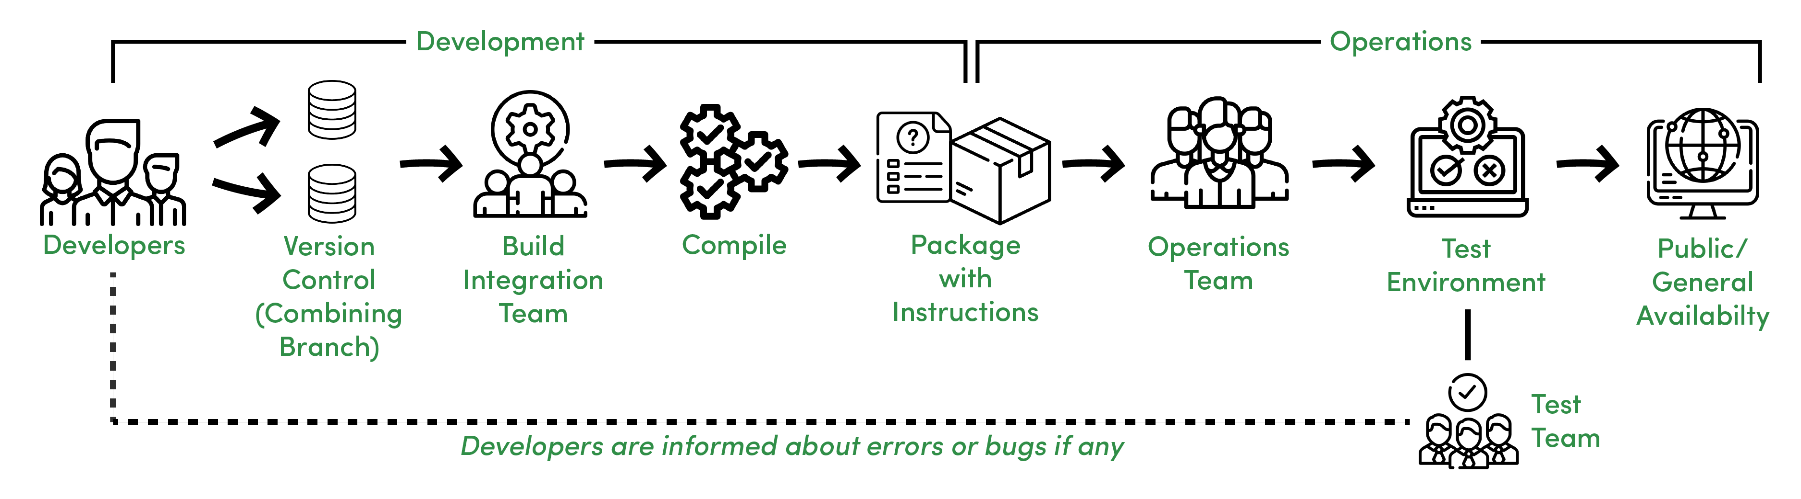
Continuous Integration

Slide 9
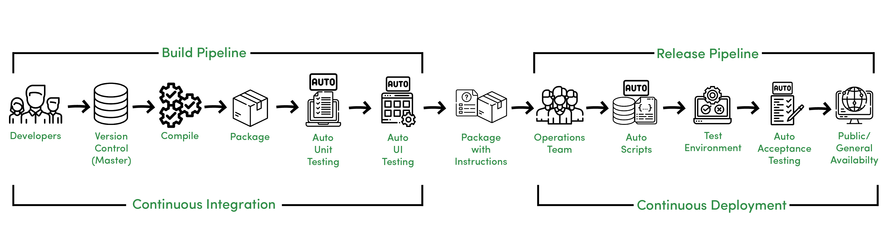
Continuous Integration

Slide 10
Continuous Integration - Phases
Phase 1 - No Build Server
Phase 2 - Nightly Builds
Phase 3 - Nightly Builds and Basic Automated Tests
Phase 4 - Enter the Metrics
Phase 5 - Getting More Serious About Testing
Phase 6 - Automated Acceptance Tests and More Automated Deployment
Phase 7 - Continuous Deployment

Slide 11
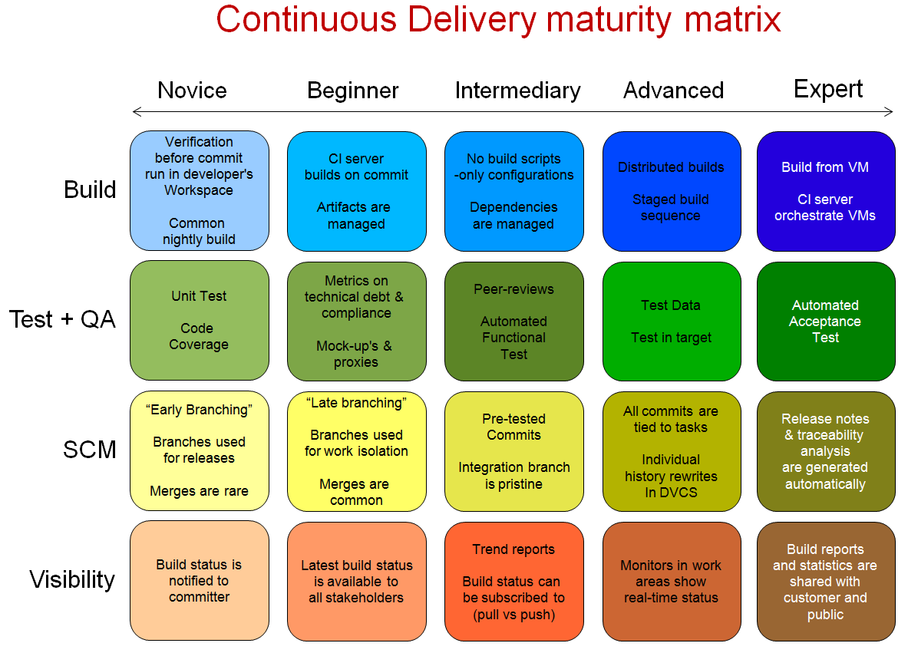
Continuous Delivery Maturity Matrix

Slide 12
Continuous Integration - Stages
Trigger
Code Checkout
Compile / Build
Unit test
Package
Functional testing
Deployment
Code Scan

Slide 13
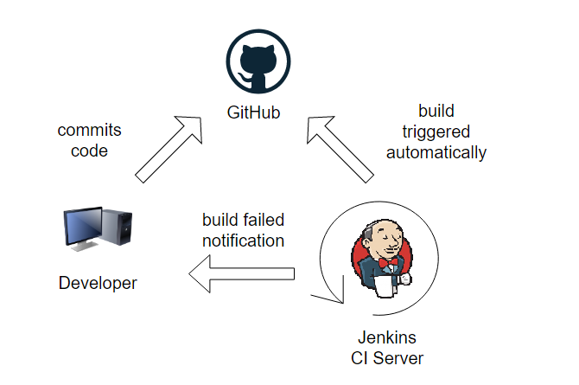
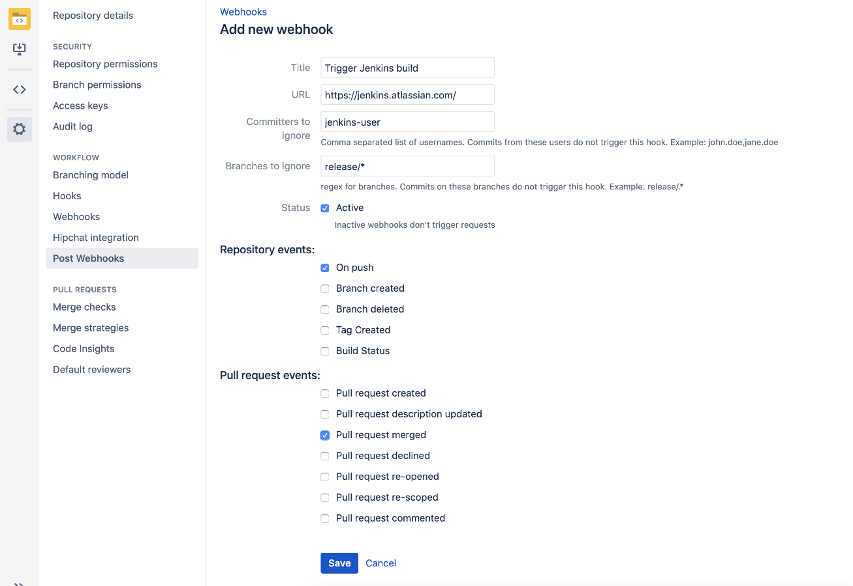
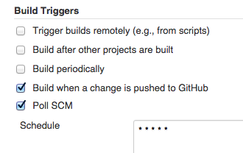
Continuous Integration - Stages
Trigger
Manual trigger
Automated trigger
Scheduled
Event based
Poll
using webhook

Slide 14
Continuous Integration - Stages
Code Checkout
Fresh checkout
Commit based checkout
Compile the code
Build script
Unit testing
Usually build script itself will have trigger to execute unit testing
Code scan
Sonarqube is the widely used code scan tool
It scans for coding standards, coverage, basic security
We can set quality gate and based on the result either approve or reject the build.

Slide 15
Continuous Integration - Stages
Package
Build output / artifacts
Container image
Functional testing / acceptance testing
Reduces time spent on manual testing
Selenium, cucumber etc..
Approval
Approval stage for getting approval before deployment
Notifications
We can have email triggers, chat notifications etc… after the each stage.
Deployment
Best practice is to have CI and CD in a separate pipelines. Build & deploy pipeline.

Slide 16
Pipeline Vocabulary
Step - a single task. Steps tell Jenkins what to do.
Node - a “node” is a step that does two things,
Schedules the steps contained within it to run by adding them to the Jenkins build queue
Creates a workspace, meaning a file directory specific to a particular job, where resource-intensive processing can occur without negatively impacting your pipeline performance. Workspaces last for the duration of the tasks assigned to them.
Stage
A “stage” is a step that calls supported APIs. Pipeline syntax is comprised of stages. Each stage can have one or more build steps within it.
Familiarity with Jenkins terms such as “controller,” “agent”, and “executor” also helps with understanding how pipelines work. These terms are not specific to pipelines:
controller - A “controller” is the basic installation of Jenkins on a computer; it handles tasks for your build system. Pipeline scripts are parsed on controllers, and steps wrapped in node blocks are performed on available executors.
agent - An “agent” (formerly "slave") is a computer set up to offload particular projects from the controller. Your configuration determines the number and scope of operations that an agent can perform. Operations are performed by executors.
executor - An “executor” is a computational resource for compiling code. It can run on controller or agent machines, either by itself or in parallel with other executors. Jenkins assigns a java.lang.Thread to each executor.

Slide 17
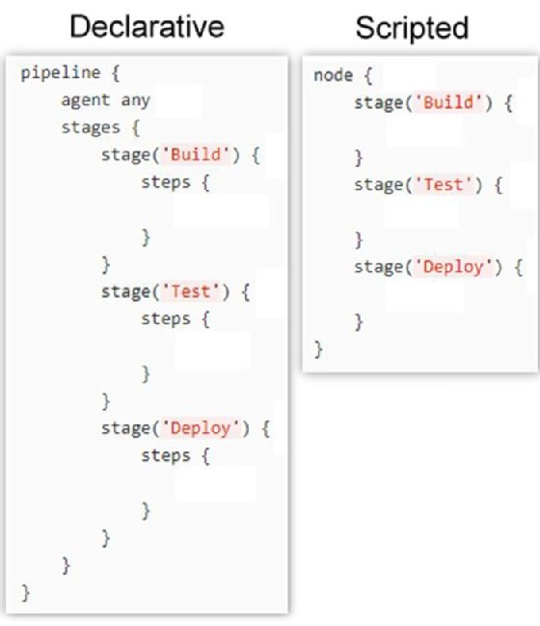
Types of Jenkins jobs
Freestyle Job
Scripted Pipeline Job
Declarative Pipeline Job
Freestyle Job
GUI based
Might not be suitable for all the scenarios
A pipeline is a collection of steps or jobs which are interlinked with one another in a sequence.
Scripted vs. declarative pipelines are different only in their programmatic approach. One uses a declarative programming model, while the other uses an imperative programming model.
But they both run on the same Jenkins pipeline sub-system. There are no differences in the runtime performance, scalability and problem solvability perspective in the declarative vs. scripted pipeline debate. They only differ in the syntactic approach used to achieve an end goal.

Slide 18
Scripted vs. Declarative Pipeline
 | Declarative | Scripted
Introduction | more recent and advanced implementation of a pipeline as a code. | the first and traditional implementation of the pipeline as a code in Jenkins
Flexibility & Simplicity | a simpler, more opinionated & well-defined syntax for authoring Jenkins Pipeline. | a tremendous amount of flexibility and extensibility to Jenkins users
Programming Model | Declarative Programming Model | Imperative Programming Model
Limitations | limits what is available to the user with a more strict and pre-defined structure, making it an ideal choice for simpler CI/CD pipelines. | very few limits, such as structure and syntax are the only limits defined by Groovy itself. It is an ideal choice for those users who have more complex requirements.
Integration | integrated with Blue Ocean | does not support Blue Ocean integration
Functional | Supports code validation. Code validation gets done before executing any stage | doesn’t support any kind of code validation
Restart from Stage | support to restart from the failed stage | does not support the “Restart from Stage” option
Options | supports Options block | does not support the Options block
Skip Stage | stages can be skipped using the “When” block | stages can not be skipped totally
Environment block | supports the Environment block | does not support Environment block
Cross functional support | integrate the scripted pipeline block in a declarative pipeline inside the “script” step | Declarative pipeline-specific blocks cannot be used in a scripted pipeline.

Slide 19
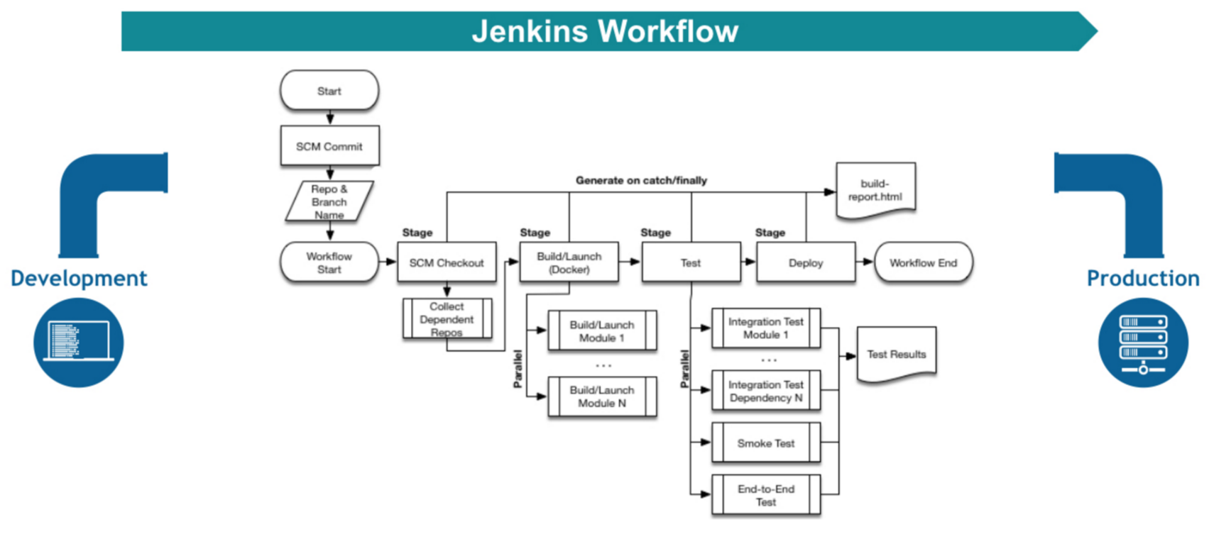
Pipeline

